Slide 1
New York Restaurants

Slide 2
Concentration of Restaurants by Area
In the next slide it is possible to check that Manhattan is the area with the biggest concentration of restaurants, on the other hand Staten Island has smallest concentration of restaurants;
Meanwhile, the other areas are more close to the average in term of concentration of restaurants.

Slide 3
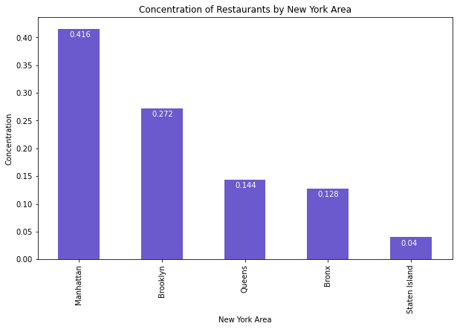
Concentration of Restaurants by Area

Slide 4
Concentration of Restaurants by Category
It’s evident the abundancy of chinese restaurants in New York;
Other relevant point is the substantial concentration of restaurants relative to the american continent in counterpart to other continents;
Spanish and Italian almost covers the rest of restaurants.

Slide 5
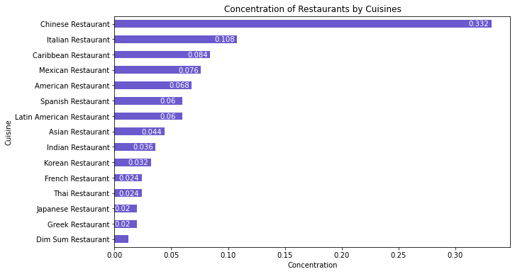
Concentration of Restaurants by Category

Slide 6
Magnitude of Rating, Price and Likes
In the next three slides it’s possible to check a simetry in the different maps, indicating a certain level of correlation between the variables.
Similarly, the maps are divided in two well-defined regions one central and other coastal;
The coastal is almost independent of the location data studied;
The central, as shown in the maps, has better cost per benefit, while the coastal is more popular.

Slide 7
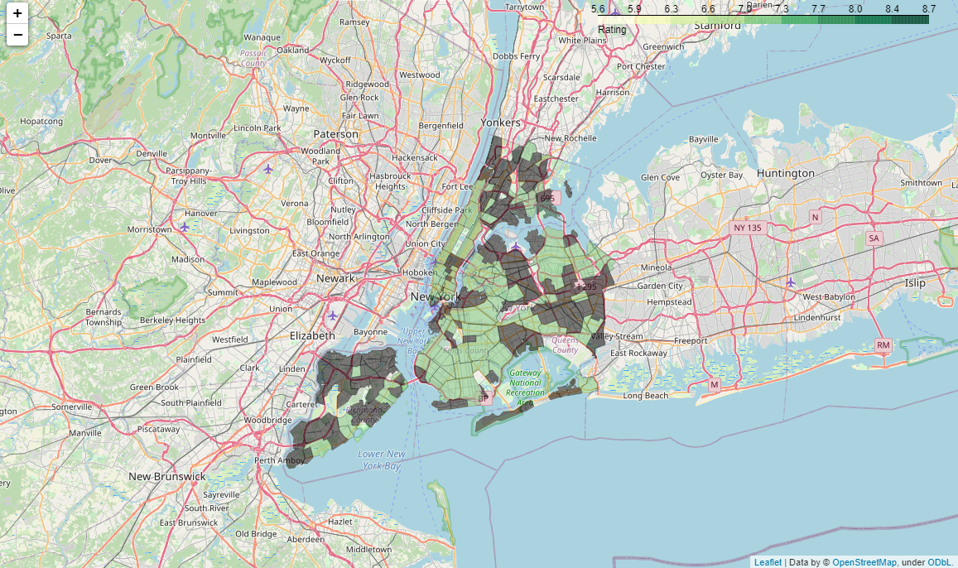
Magnitude of Rating, Price and Likes

Slide 8
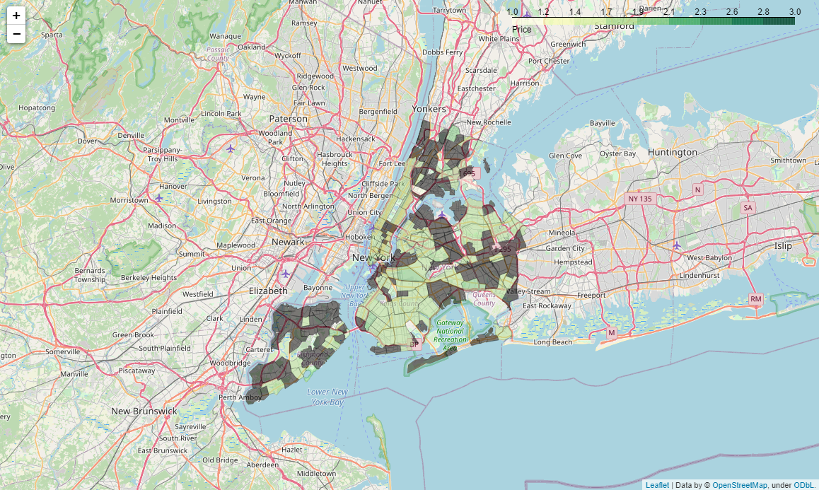
Magnitude of Rating, Price and Likes

Slide 9
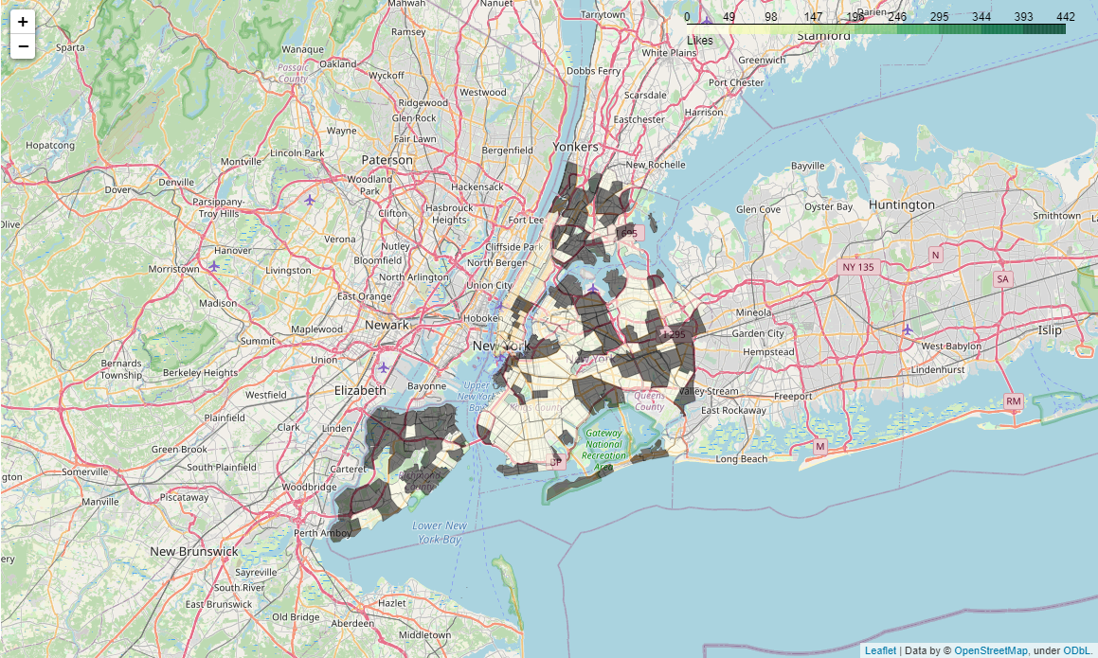
Magnitude of Rating, Price and Likes

